Slide 1

AKASH VIGNYAN KENDRA
PYTHON -521 PROJECT
Shruti Krishna Pagadala

Slide 2

Project intro
The user enters the rocket's dimensions such as its height, weight etc. as well as the name of the planet to launch. My Python program will determine whether the rocket can escape the planet's gravitational pull or not.

Slide 3
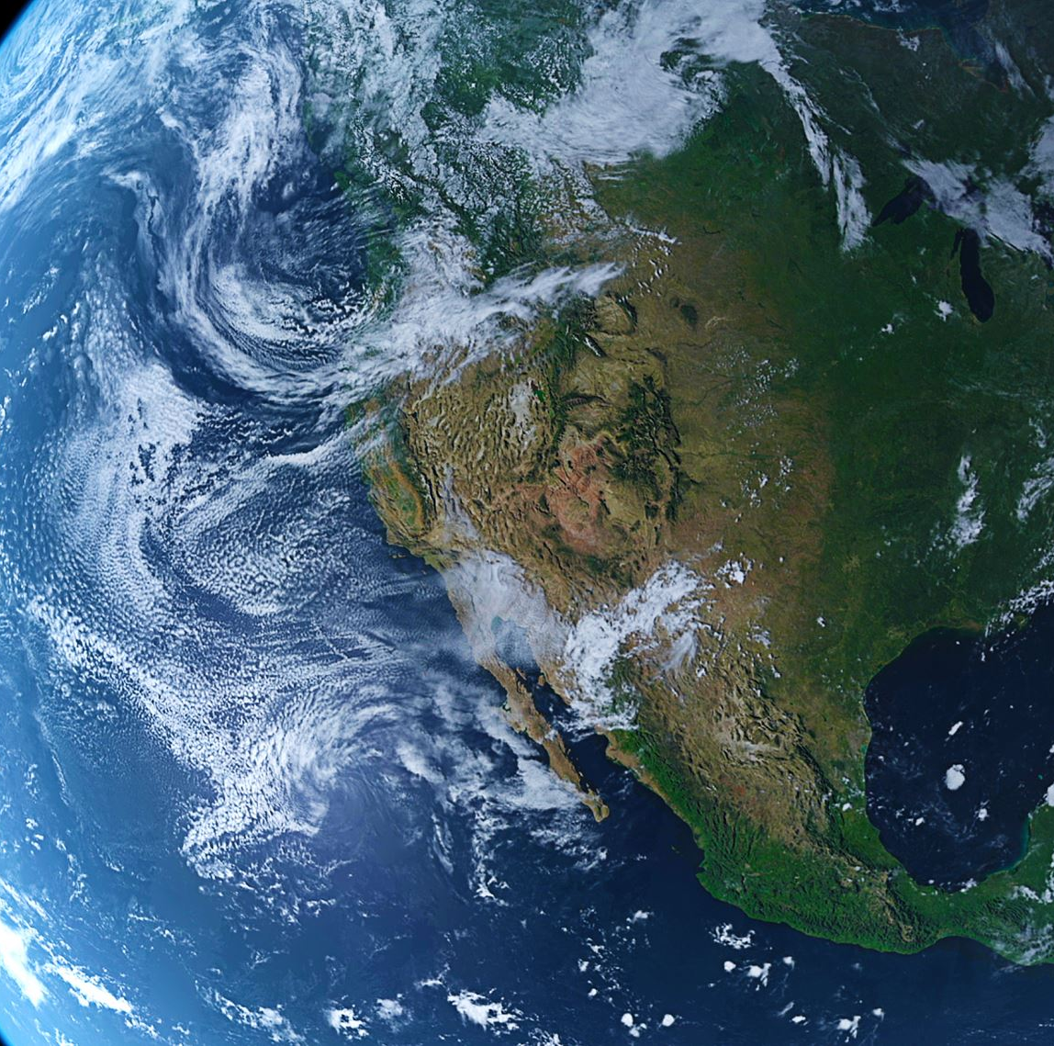
What is Escape Velocity?
Escape velocity is the minimum velocity required by a body to be projected to overcome the gravitational pull of the planet.

Slide 4

How Do You Calculate Escape Velocity?
Escape velocity is a function of the orbital velocity of an object. If you take the velocity required to maintain orbit at a given altitude and multiply it by the square root of 2 (which is approximately 1.414), you will derive the velocity required to escape orbit and the gravitational field controlling that orbit.

Slide 5
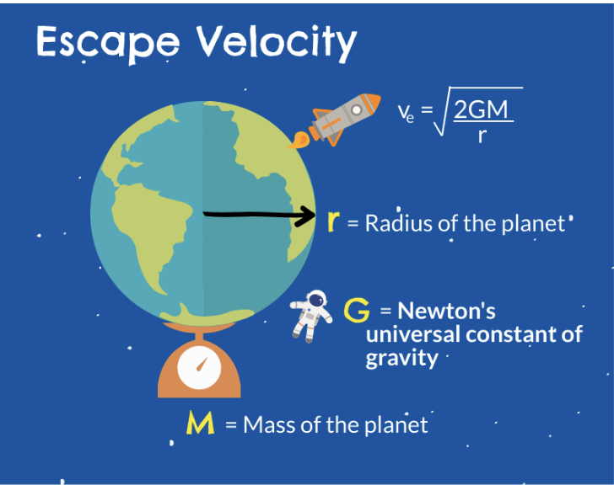
Calculation of escape velocity

Slide 6

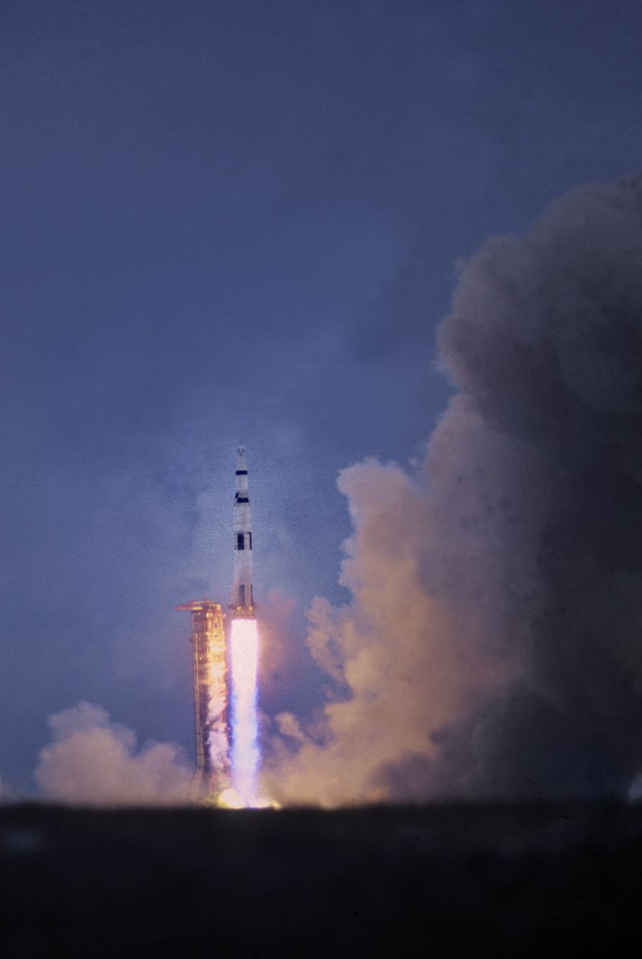
Conservation of ENERGY
Newton’s Third Law Whenever one body exerts a force on another, the second body exerts a force equal in magnitude and opposite in direction on the first body.
Conservation of energy states that the total energy of an isolated system remains unchanged. In the derivation , we will work with an Earth-rocket system and assume that this system is isolated.
To launch, the rocket needs enough propellants so that the thrust pushing the rocket up is greater than the force of gravity pulling the rocket down. A rocket needs to speed up to at least 17,800 miles per hour—and fly above most of the atmosphere, in a curved path around Earth.

Slide 7

Escape Velocity of Earth:
From the above equation, the escape velocity for any planet can be easily calculated if the mass and radius of that planet are given. For earth, the values of g and R are:
g = 9.8 ms⁻²
R = 63,781,00 m
So, the escape velocity will be:
v_{e}=2×9.8×63,781,00
Escape Velocity of Earth= 11.2 km/s.
This is the derivation of the escape velocity of earth. For any other planet we can derive at the escape velocity in the similar pattern
Notes:
Deriving escape velocity using calculus[edit]
Let G be the gravitational constant and let M be the mass of the earth (or other gravitating body) and m be the mass of the escaping body or projectile. At a distance r from the centre of gravitation the body feels an attractive force
F=GMmr2.The work needed to move the body over a small distance dr against this force is therefore given by
dW=Fdr=GMmr2dr.The total work needed to move the body from the surface r₀ of the gravitating body to infinity is then^{[17]}
W=∫r0∞GMmr2dr=GMmr0=mgr0.In order to do this work to reach infinity, the body's minimal kinetic energy at departure must match this work, so the escape velocity v₀ satisfies
12mv02=GMmr0,which results in
v0=2GMr0=2gr0.

Slide 8
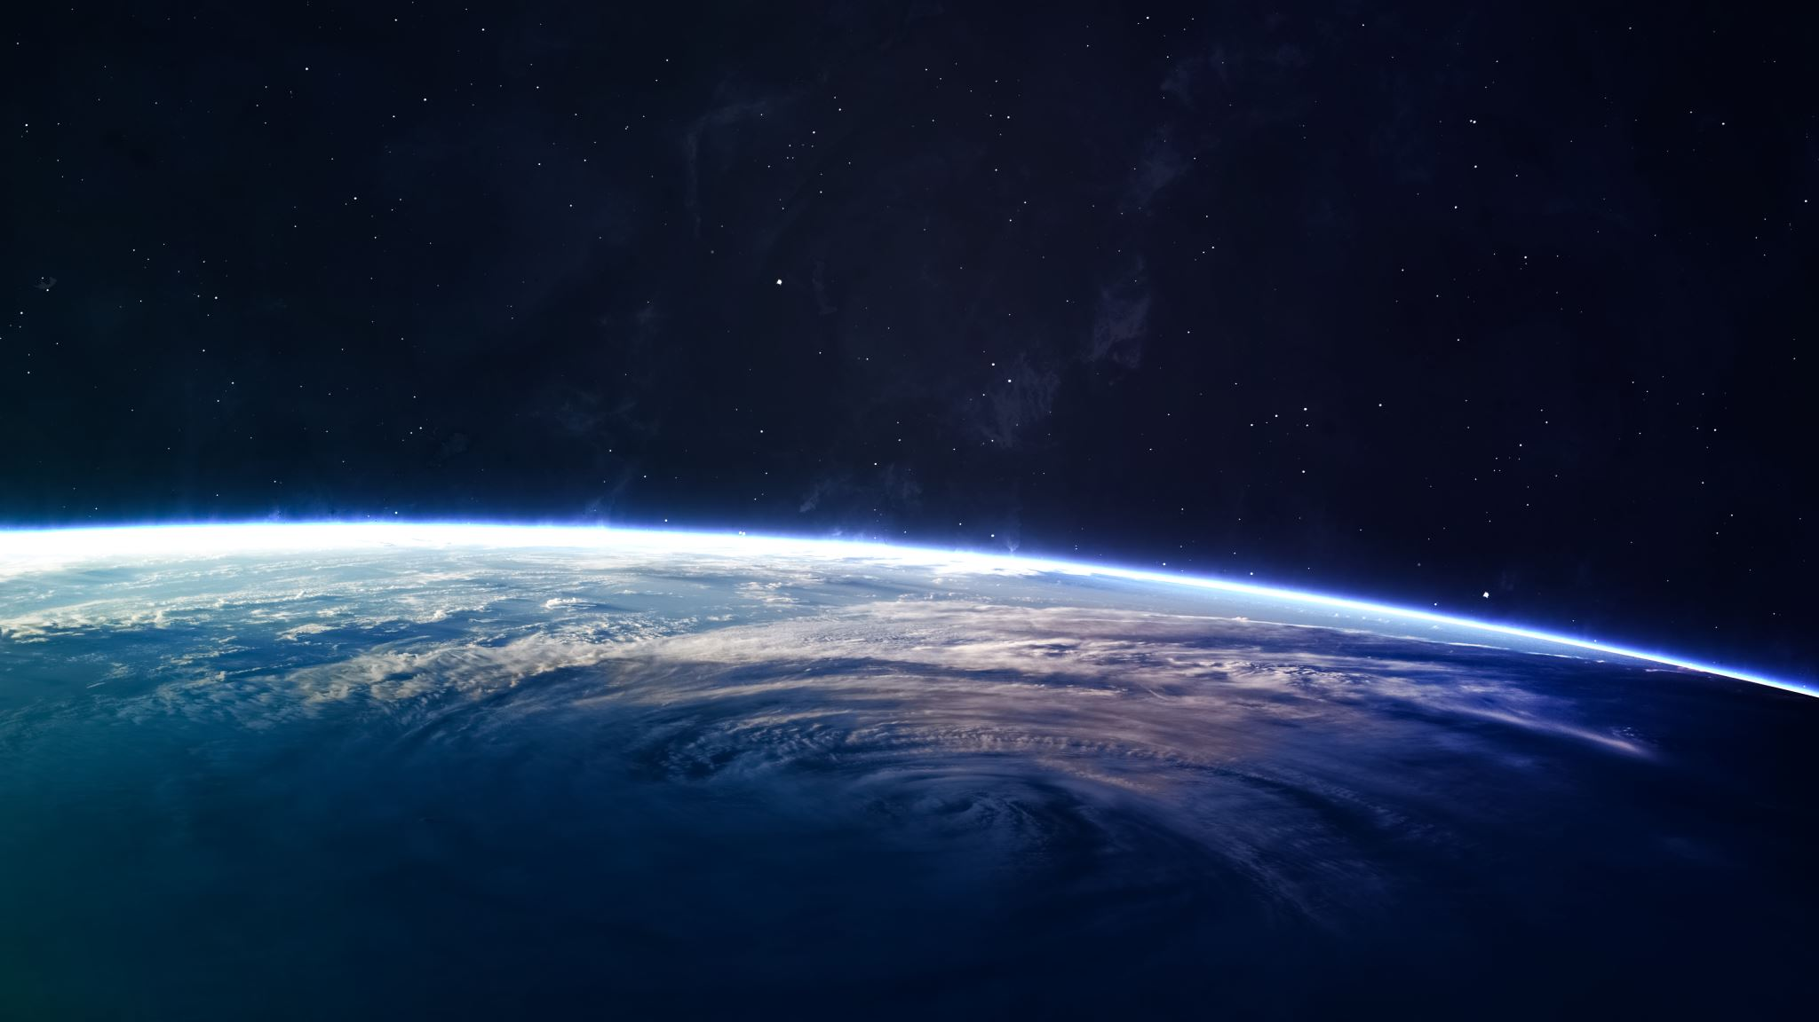
SCOPE
You can calculate the escape velocity from any body in space as long as you know its RADIUS and its MASS. For example, using the above equation, we can calculate the escape velocity of the Moon. From its equator, the Moon has a radius of 1 738 km. It also has an estimated mass of 7.342 × 10²² kg. This means that the Moon’s escape velocity is 2.38 km/s. That is much less than the 11.2 km/s it takes to get off the Earth. In the future, perhaps rockets will be built on and take off from the Moon rather than from Earth.

Slide 9
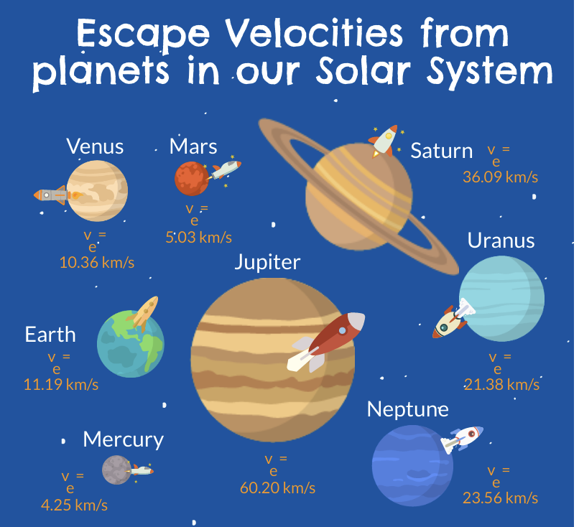

Slide 10
INPUTS
Rockets' width
Planet’s name
Rocket’s height
Rocket’s mass

Slide 11
OUTPUT
The program takes the input after checking the parameters given by us , it gives two kinds of outputs-
“The rocket can escape the planet's gravitational pull”
The rocket cannot escape the planet's gravitational pull- and it also gives what the mass of the rocket should be and its thrust in-order to escape the planet

Slide 12


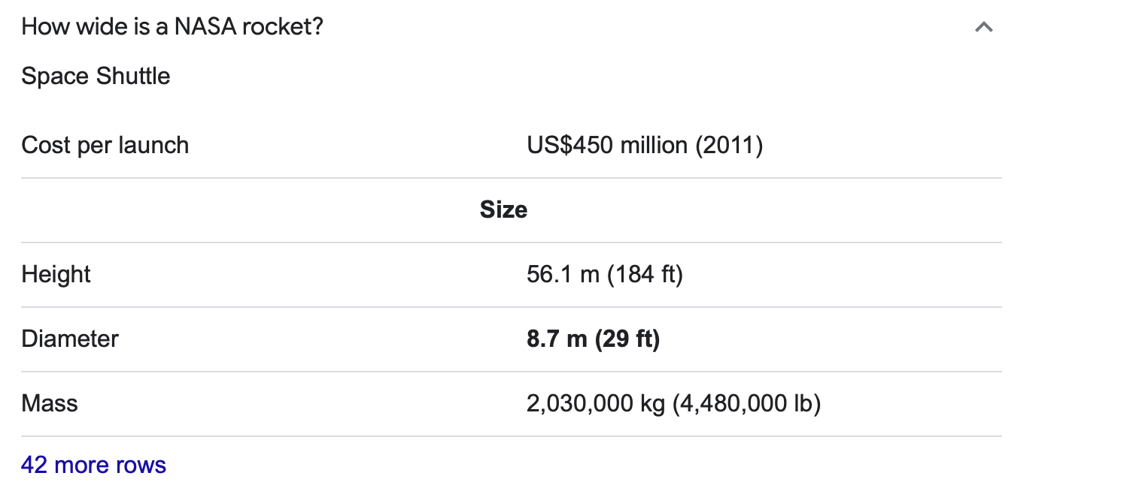
GENERAL MEASUREMENTS OF A ROCKET

Slide 13
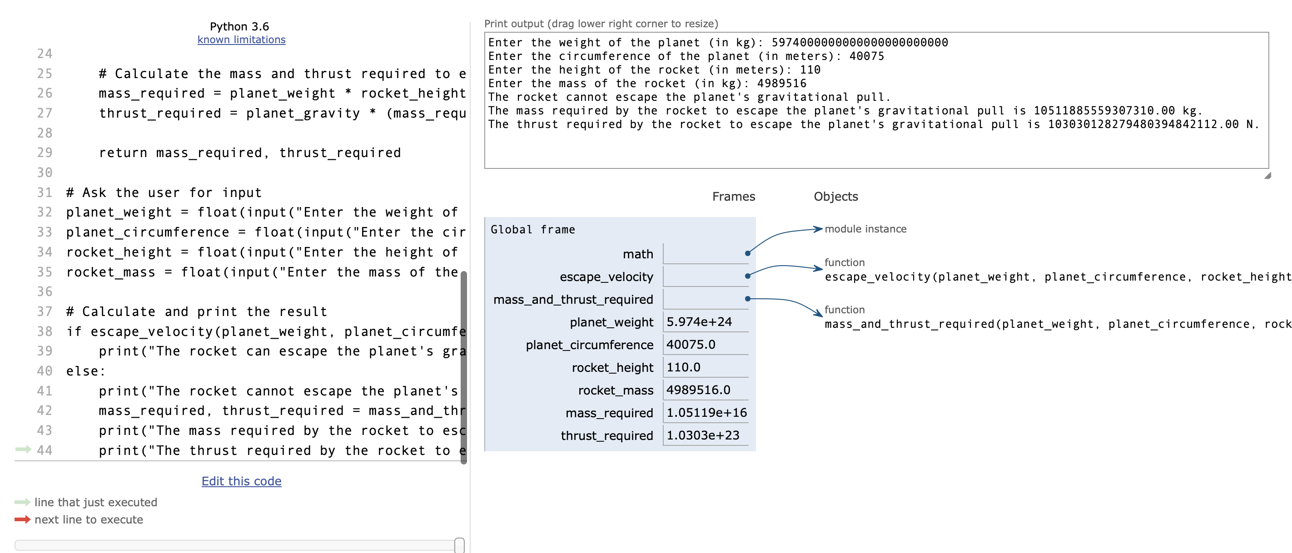

Slide 14

references
https://www.wikihow.com/Calculate-Escape-Velocity
https://en.wikipedia.org/wiki/Escape_velocity#:~:text=On%20the%20surface%20of%20the,to%201.7%20km%2Fs).
https://www.masterclass.com/articles/learn-how-escape-velocity-works#
https://www.teachengineering.org/lessons/view/cub_mars_lesson04
https://letstalkscience.ca/educational-resources/stem-in-context/escape-velocity#:~:text=Space%20is%20usually%20considered%20to,enter%20orbit%20around%20the%20Earth.
https://www.grc.nasa.gov/www/k-12/rocket/rktenglab.html
https://howthingsfly.si.edu/ask-an-explainer/how-much-force-rocket-launch
https://www.sciencelearn.org.nz/resources/389-lift-off
https://www.vanderbilt.edu/AnS/physics/astrocourses/AST101/readings/escape_velocity.html

